Slide 1
Module-1: Human and Environment
Introduction to Human and the Environment: Overview of human-environment interactions throughout history;
Importance of mastery of fire, the origin of agriculture, and the emergence of city-states;
Discussion on the impact of ancient civilizations on the environment.
Emergence of Environmentalism: Anthropocentric and eco-centric perspectives;
Study of significant thinkers and their contributions to environmental philosophy;
Environmental movements, Analysis of critical events such as the UN Conference on Human Environment 1972.

Slide 2
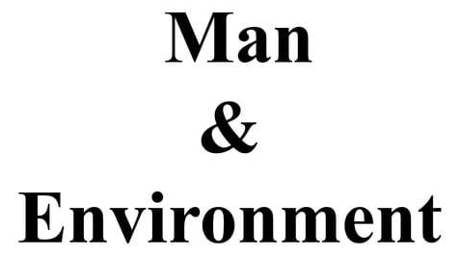

Slide 3
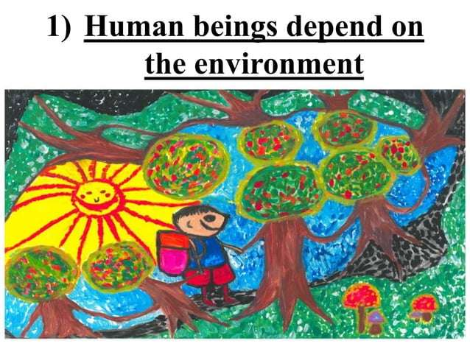

Slide 4
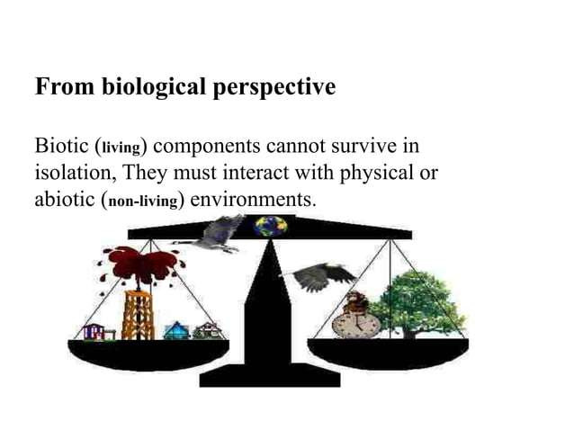

Slide 5
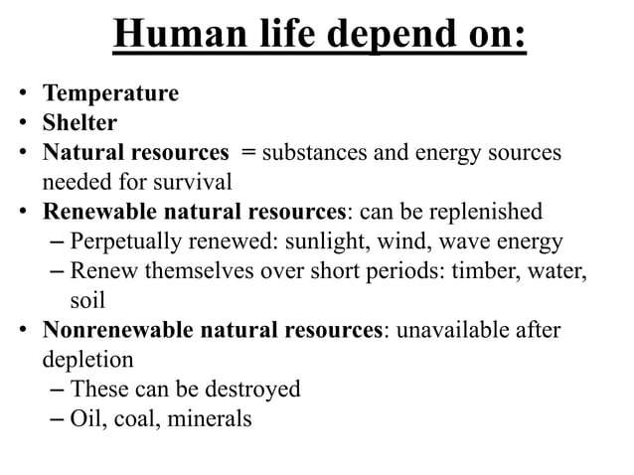

Slide 6
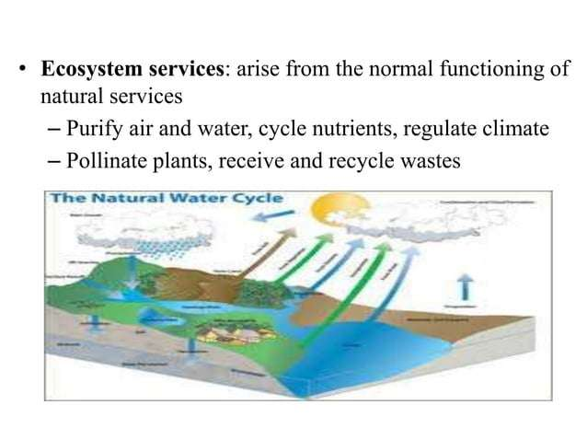

Slide 7
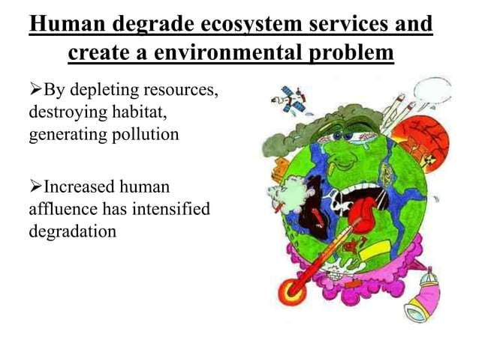

Slide 8
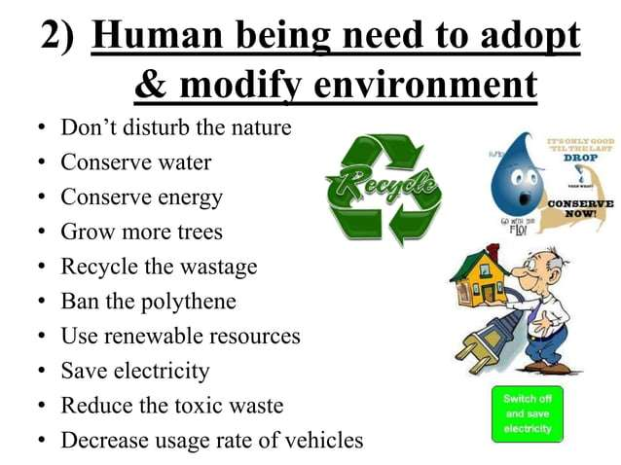

Slide 9


Slide 10
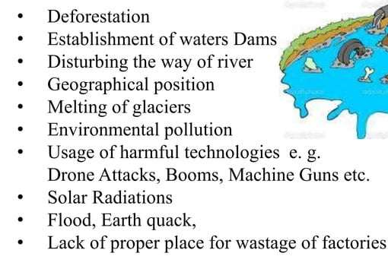
Factors affecting our Environment

Slide 11
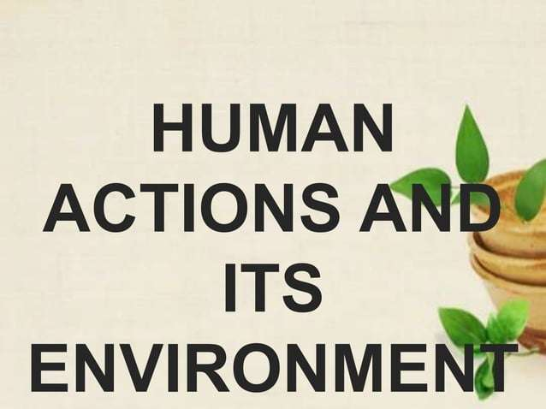

Slide 12
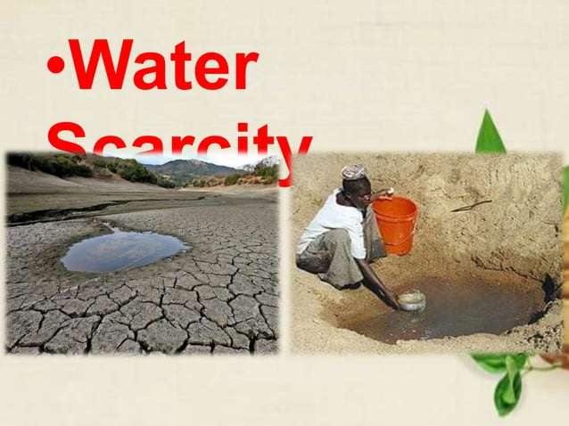

Slide 13
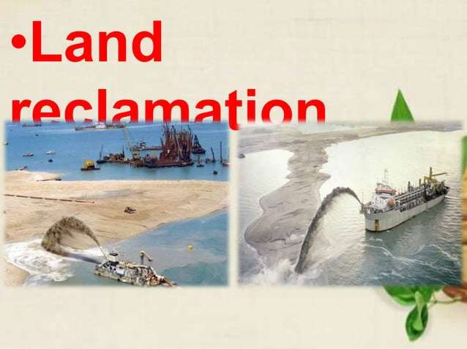

Slide 14


Slide 15


Slide 16


Slide 17


Slide 18


Slide 19


Slide 20
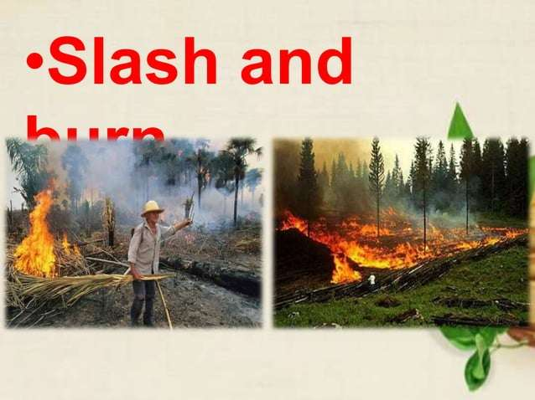

Slide 21
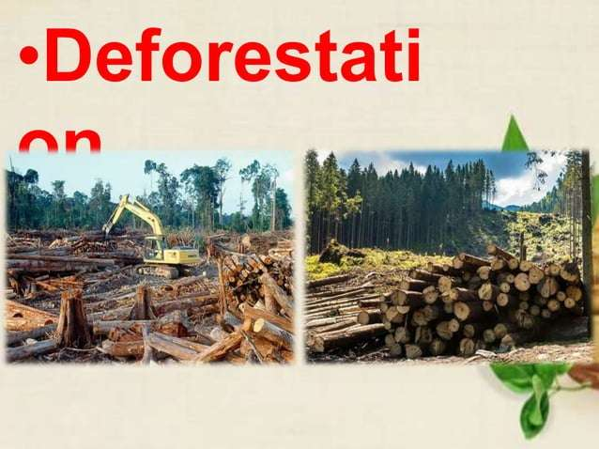

Slide 22


Slide 23


Slide 24
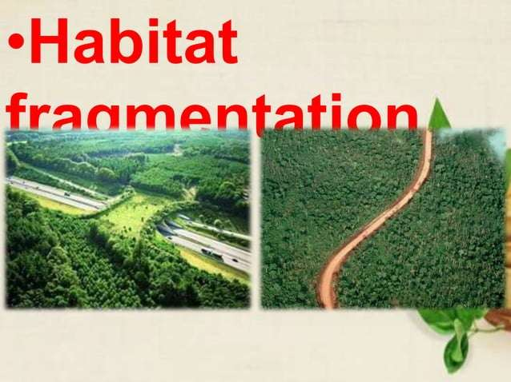

Slide 25
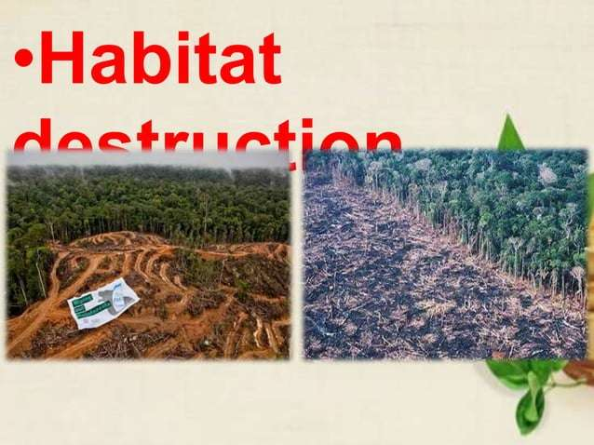

Slide 26
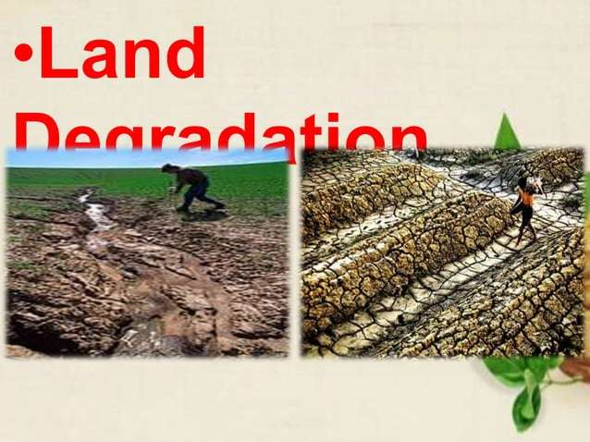

Slide 27
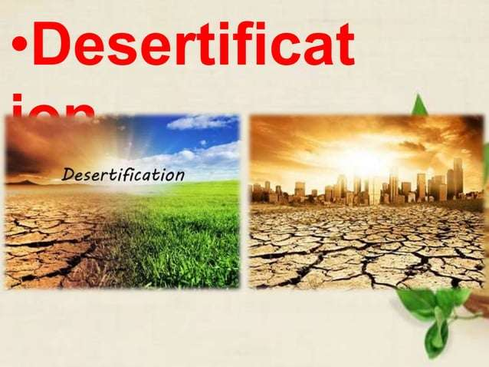

Slide 28
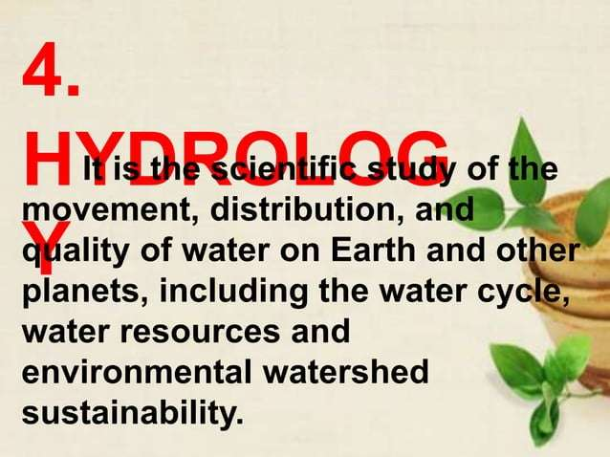

Slide 29
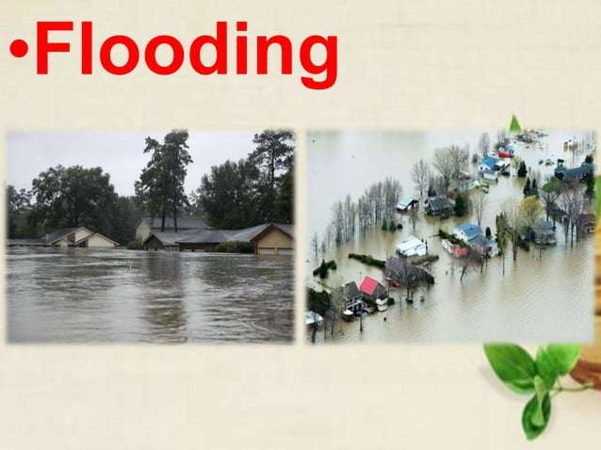

Slide 30
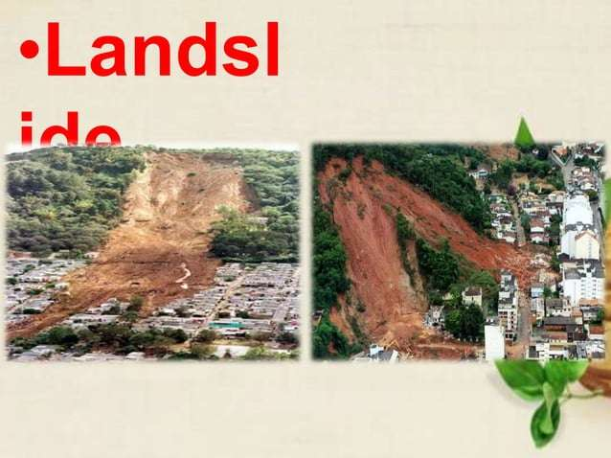

Slide 31
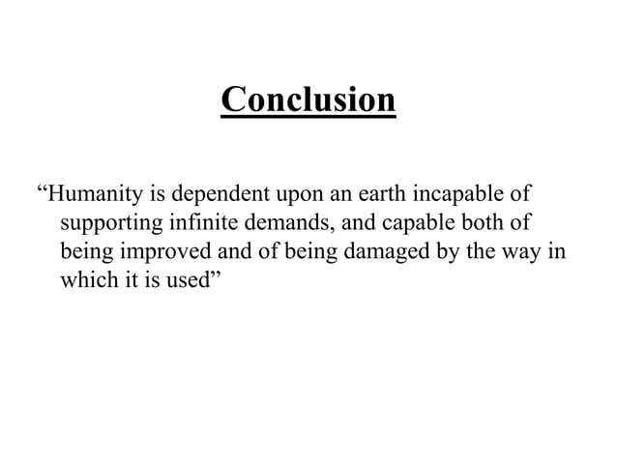

Slide 32


Slide 33
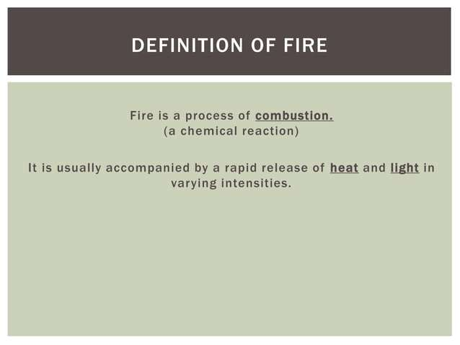

Slide 34
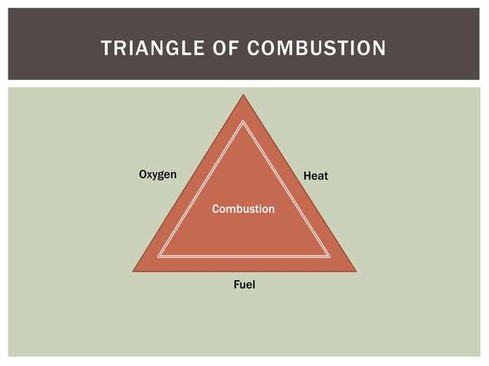

Slide 35


Slide 36


Slide 37
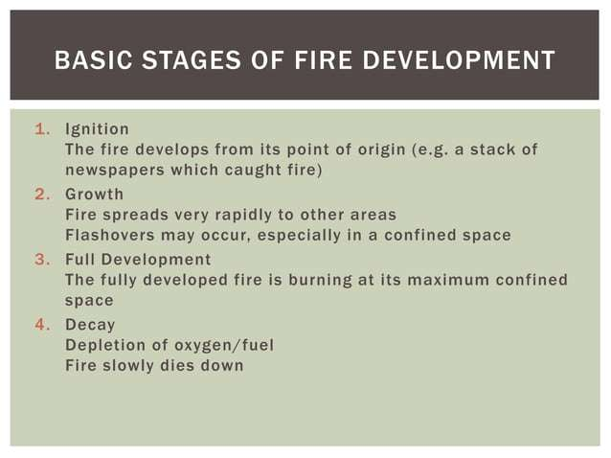

Slide 38
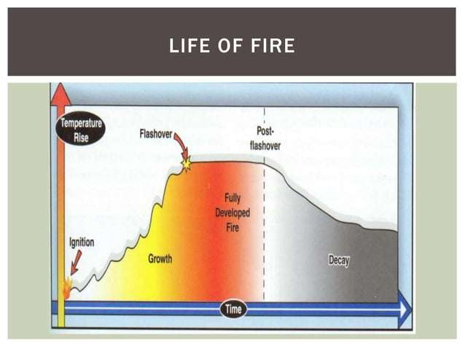

Slide 39
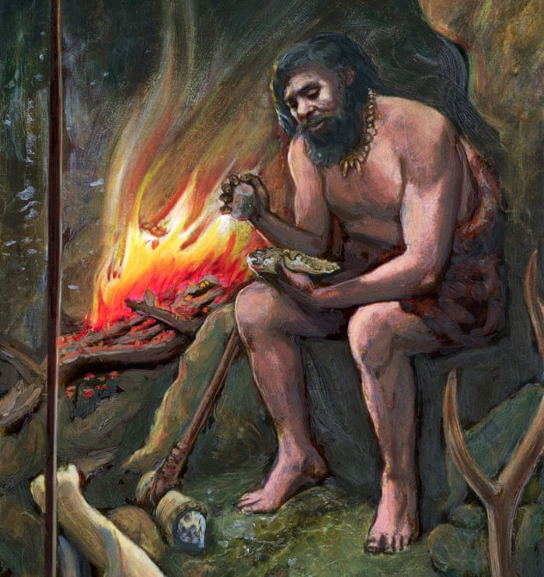


Importance of mastery of fire

Slide 40
The ability to control fire was a major technological advancement in human history that had many important consequences, including:
Warmth and protection: Fire provided a source of warmth and protection from predators, especially at night.
Cooking: Cooking food provided humans with the nutrition to develop larger brains and increased intelligence. It also allowed humans to gather in shared spaces, which helped to evolve the social aspect of modern human life.
Hunting tools: Fire was used to create more advanced hunting tools.
Cultural innovations: Fire played an instrumental role in human cultural evolution.
Geographic dispersal: Fire allowed humans to disperse geographically.
Diet and behavior: Fire led to changes in diet and behavior.

Slide 41
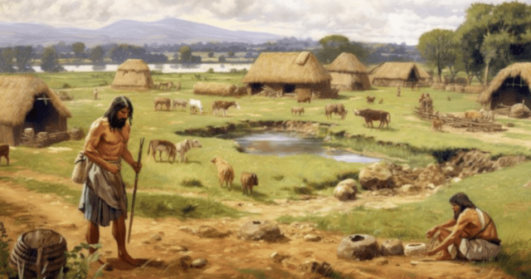
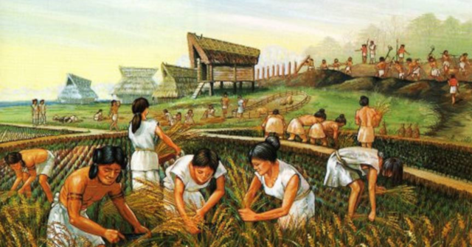
The origin of agriculture, and the emergence of city-states
The origin of agriculture and the emergence of city-states are two pivotal milestones in human history, each marking a significant shift in how societies were organized and how humans interacted with their environment.
Origin of Agriculture:
Timeframe: Agriculture is believed to have originated during the Neolithic period, around 10,000 BCE. This period is often referred to as the Neolithic Revolution or the Agricultural Revolution.

Slide 42
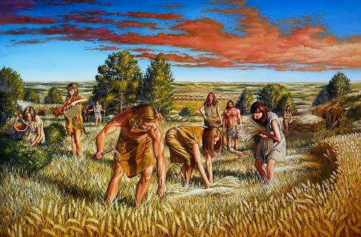
Location: Agriculture arose independently in several parts of the world, including:
The Fertile Crescent (modern-day Iraq, Syria, Israel, and Jordan) around 10,000 BCE.
China, particularly along the Yangtze and Yellow Rivers, around 7,000-6,000 BCE (rice and millet farming).
Mesoamerica (Mexico and Central America), where maize, beans, and squash were cultivated around 6,500 BCE.
The Indus Valley (modern-day Pakistan and northwest India) around 7,000 BCE.
Sub-Saharan Africa, where sorghum, millet, and yams were domesticated.
Process of Domestication: Agriculture began with the domestication of plants and animals. Early humans selected and cultivated wild plants (like wheat, barley, rice, and maize) and animals (like goats, sheep, and cattle) for their desirable traits (e.g., size, yield, and temperament). This shift from foraging to farming allowed humans to produce a stable food supply, reducing reliance on hunting and gathering.

Slide 43
Emergence of City-States:
Timeframe: The emergence of city-states occurred later, around 3,500-3,000 BCE, with the first city-states forming in Mesopotamia (Sumer) and later in regions like Egypt, the Indus Valley, and Mesoamerica.
Definition of a City-State: A city-state is a political entity that consists of a single city and its surrounding territory. It is both a city and an independent state, with its own government, laws, and military.
Mesopotamia (Sumer): The earliest known city-states emerged in the region of Sumer in Mesopotamia, where cities like Uruk, Ur, and Lagash developed around 3,500 BCE. These cities were often centered around a temple or religious institution (the ziggurat) and were ruled by kings or priest-kings.

Slide 44
Egypt and the Nile Valley: Around the same time, Egypt saw the rise of city-states that eventually united into larger political entities under powerful rulers like the pharaohs. The development of irrigation along the Nile River allowed for the creation of a stable agricultural base, leading to surplus production, trade, and urbanization.
Indus Valley Civilization: Around 2,600 BCE, cities like Harappa and Mohenjo-Daro emerged in the Indus Valley (modern-day Pakistan and India). These cities were highly planned, with advanced drainage systems and standardized building layouts, reflecting sophisticated governance.
Mesoamerica: In Mesoamerica, city-states like Teotihuacan and the early Mayan city-states (e.g., Tikal and Calakmul) emerged around 1,000-500 BCE. These civilizations also relied heavily on agriculture, particularly the cultivation of maize, and developed complex social hierarchies and religious institutions

Slide 45
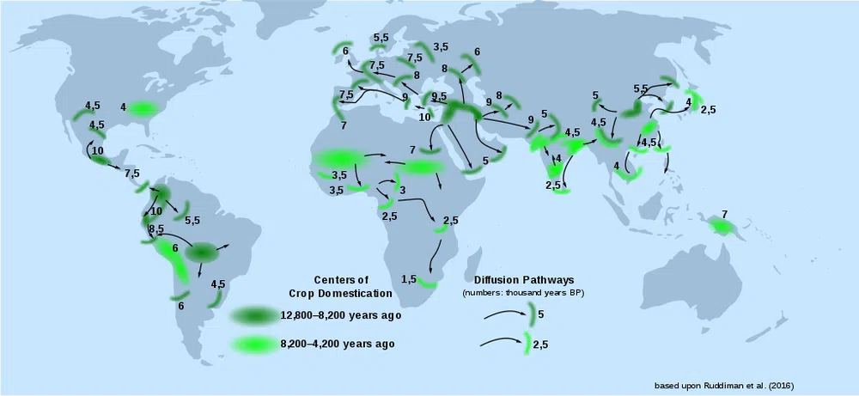

Slide 46
The impact of ancient civilizations on the environment.
Ancient civilizations impacted the environment in many ways, including:
Deforestation: The use of bronze axes to clear forests for agriculture led to widespread deforestation.
Loss of biodiversity: The clearing of forests led to a reduction in biodiversity.
Changes to the carbon cycle: The burning of forests for agriculture and the drainage of wetlands for rice cultivation released greenhouse gases and methane into the atmosphere.
Soil erosion: The cutting of forests led to soil erosion, which extended coastal plains seaward. This caused many ancient cities, such as Troy, Myceneae, and Ephesus, to move inland.
Domestication of plants and animals: Humans began to domesticate plants and animals, making them dependent on human interaction.
Climate Change and Collapse of Civilizations
Environmental degradation often played a role in the decline or collapse of ancient civilizations, as the depletion of natural resources or changes in climate made it difficult for societies to survive.

Slide 47

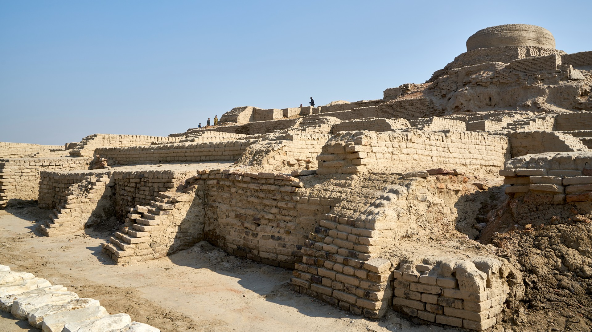

Mayan pyramid in Chichen-Itza, Mexico
Indus Valley civilization

Slide 48
Emergence of Environmentalism: Anthropocentric and eco-centric perspectives
The emergence of environmentalism is rooted in the growing awareness of human impacts on the natural world, evolving over time through various philosophical and ethical frameworks. Two key perspectives that have shaped environmental thought are anthropocentrism and eco-centrism.
1. Anthropocentric Perspective
Definition: Anthropocentrism is a human-centered view of the world, where nature and the environment are valued primarily for their utility and benefits to human beings. It places humans at the center of moral consideration, with nature regarded as a resource to be managed and used for human well-being.
Key Features:
Human Dominance: The belief that humans are the most important entities in the universe, and nature exists to serve human needs. This perspective has historically underpinned many of the world's major religions, philosophies, and economic systems.
Conservation for Human Benefit: In the anthropocentric view, environmental protection is justified to the extent that it benefits humans. Conservation efforts are often driven by the need to ensure sustainable resources, prevent harm to human health, and maintain economic productivity.
Environmentalism as Resource Management: This perspective supports the idea of sustainable development, where the environment is protected primarily to ensure the long-term availability of resources for human use. For example, preserving forests is seen as important because they provide oxygen, timber, and recreational spaces for people.

Slide 49

Anthropocentric Perspective

Slide 50
Eco-Centric Perspective
Definition: Eco-centrism is a nature-centered worldview that places intrinsic value on all living organisms and ecosystems, regardless of their usefulness to humans. It emphasizes the interconnectedness of all life forms and the importance of protecting the environment for its own sake.
Key Features:
Intrinsic Value of Nature: Eco-centrism holds that nature has value independent of human needs or desires. All life forms, from plants and animals to ecosystems and landscapes, have the right to exist and flourish.
Interdependence: This perspective emphasizes the interconnectedness of humans and nature, where human well-being is seen as dependent on the health of ecosystems. Eco-centrism often advocates for a holistic approach to environmental protection, recognizing that damaging one part of the ecosystem can have ripple effects on the whole.
Ethical Responsibility: Eco-centric environmentalism is grounded in an ethical responsibility to protect the environment not just for human benefit but for the well-being of all species. This perspective leads to a more radical critique of human exploitation of nature and often calls for more stringent environmental protection policies.

Slide 51
Eco-Centric Perspective

Slide 52
Conclusion
The emergence of environmentalism reflects a growing awareness of humanity’s impact on the planet.
Anthropocentric and eco-centric perspectives represent two key ways of understanding the relationship between humans and nature. While anthropocentrism focuses on the benefits of the environment for humans and sustainable management of resources, eco-centrism emphasizes the intrinsic value of nature and advocates for its protection beyond human interests.
Both perspectives contribute to contemporary environmental thought and policy, shaping how we address global environmental challenges like climate change, biodiversity loss, and resource depletion.

Slide 53
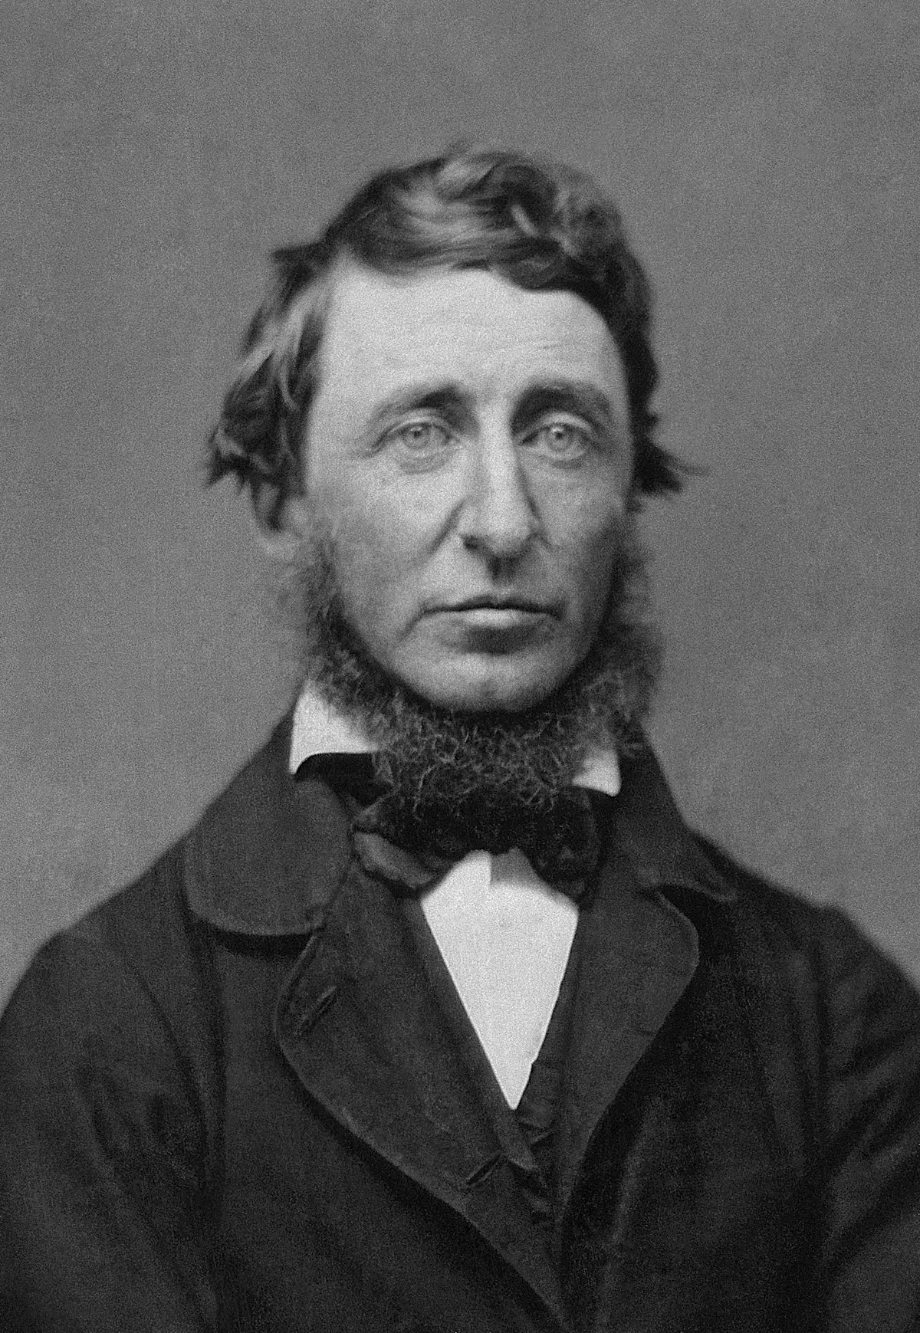
Significant thinkers and their contributions to environmental philosophy
Environmental philosophy has evolved through the contributions of significant thinkers who have shaped how we understand the relationship between humans and the natural world. These philosophers and activists have offered varying perspectives on the ethical, social, and ecological dimensions of environmental issues. Here are some of the most significant thinkers and their contributions to environmental philosophy:
Henry David Thoreau (1817–1862)
Major Work: Walden (1854), Civil Disobedience (1849)
Contributions:
Thoreau is considered one of the earliest environmental philosophers. In Walden, he reflects on simple living, self-sufficiency, and the spiritual and philosophical significance of nature.
He emphasized the idea that humans are part of nature and should live in harmony with it. His philosophy was a reaction against industrialization and urbanization in 19th-century America, advocating for a closer connection to the natural world.
Thoreau also believed in nature's intrinsic value and viewed it as a source of moral guidance. His writings inspired later conservation movements, particularly in the United States.

Slide 54
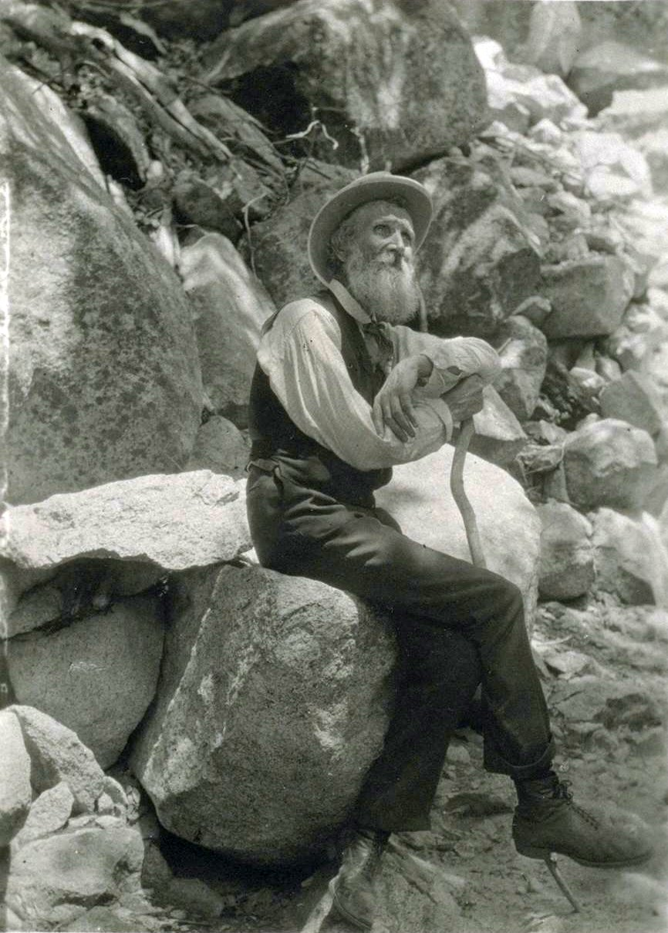
John Muir (1838–1914)
Major Work: Our National Parks (1901), The Yosemite (1912)
Contributions:
Known as the "Father of the National Parks," Muir was a naturalist, writer, and advocate for wilderness preservation. His writings and activism played a crucial role in the establishment of national parks in the United States, such as Yosemite and Sequoia.
Muir’s environmental philosophy was grounded in an eco-centric perspective, emphasizing the intrinsic value of nature. He believed that wild places should be protected for their own sake, not just for human use or enjoyment.
His work laid the foundation for the modern environmental preservation movement, and his influence helped shape the creation of the Sierra Club, a leading environmental organization.

Slide 55

Aldo Leopold (1887–1948)
Major Work: A Sand County Almanac (1949)
Contributions:
Leopold is best known for his concept of the "land ethic," which he introduced in A Sand County Almanac. This ethic expands the moral community to include "soils, waters, plants, and animals," emphasizing that humans are part of an ecological community.
He argued that ethical responsibility toward nature should be based on respect for the integrity, stability, and beauty of the biotic community. This biocentric view places humans within the web of life rather than as conquerors over it.
Leopold’s land ethic is one of the most influential ideas in environmental philosophy, emphasizing conservation, sustainability, and the importance of maintaining healthy ecosystems.

Slide 56

Rachel Carson (1907–1964)
Major Work: Silent Spring (1962)
Contributions:
Carson is widely credited with launching the modern environmental movement through her groundbreaking book Silent Spring. The book exposed the dangers of chemical pesticides, particularly DDT, and how they were harming ecosystems, wildlife, and human health.
Carson’s work brought attention to the unintended consequences of human actions on the environment and emphasized the interconnectedness of all living things. Her arguments were grounded in science and called for caution and responsibility in the use of technology.
Silent Spring led to widespread public concern about pollution and helped inspire the creation of regulatory bodies like the U.S. Environmental Protection Agency (EPA). Carson’s legacy continues to influence environmental policy and activism.

Slide 57
Conclusion
The thinkers above have significantly shaped environmental philosophy, contributing to diverse perspectives on how humans should relate to the natural world. From Thoreau’s early reflections on nature to contemporary eco-feminism and deep ecology, these ideas continue to influence modern environmental thought and policy, as well as ongoing efforts to address pressing global environmental challenges.

Slide 58
Environmental movements
Environmental movements in India have a long and rich history, driven by various ecological, social, and cultural issues.
These movements have emerged in response to deforestation, industrial pollution, displacement of communities, and exploitation of natural resources.
Many of these movements emphasize sustainable development, the rights of indigenous people, and environmental justice.

Slide 59
1. Chipko Movement (1970s)
Overview:
The Chipko Movement is one of India's most iconic environmental movements, symbolizing grassroots activism and non-violent protest.
Objectives:
Forest Conservation: Preventing deforestation and promoting sustainable forest management.
Community Rights: Empowering local communities, particularly women, to protect their natural resources.
Key Events:
1974, Uttarakhand: The movement began in the Garhwal region when villagers, led by women, embraced (hence "Chipko," meaning "to hug" in Hindi) trees to prevent logging by contractors.
Key Figures:
Sunderlal Bahuguna: A prominent environmentalist who later played a crucial role in the Chipko Movement.
Gaura Devi: A village woman who became a symbol of the movement by physically embracing trees to stop their felling.
Impact:
Policy Influence: Led to the implementation of more stringent forest conservation laws.
Awareness: Raised national and international awareness about the importance of forests and sustainable practices.

Slide 60
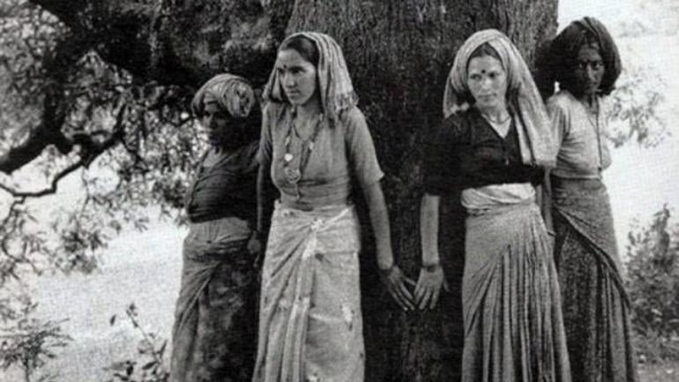
Chipko Movement

Slide 61
2. Silent Valley Movement (1970s–1980s)
Overview:
The Silent Valley Movement was a campaign to protect the Silent Valley, a pristine tropical rainforest in Kerala, from a proposed hydroelectric project.
Objectives:
Biodiversity Protection: Preserve the unique flora and fauna of the Silent Valley.
Environmental Preservation: Prevent ecological imbalance caused by large-scale infrastructure projects.
Key Events:
1970s: Initial protests began against the proposed hydroelectric dam.
1980s: Intensified activism led by environmentalists and local communities.
Key Figures:
M. P. Veerendra Kumar: A politician and environmentalist who played a significant role in mobilizing support.
Ikkanda Warrier: An environmentalist who led local protests and awareness campaigns.
Impact:
Preservation of Silent Valley: The movement successfully halted the dam project, leading to the declaration of the Silent Valley National Park in 1984.

Slide 62

Silent Valley Movement

Slide 63
3. Narmada Bachao Andolan (NBA) (1980s–Present)
Overview:
The Narmada Bachao Andolan is a social movement advocating for the rights of people affected by the construction of large dams on the Narmada River.
Objectives:
Displacement Rights: Protecting the rights and livelihoods of displaced communities.
Environmental Protection: Highlighting the ecological impact of large-scale dam projects.
Sustainable Development: Promoting alternative methods of development that are environmentally and socially sustainable.
Key Events:
1985: Formation of the NBA led by activists like Medha Patkar.
1990s–Present: Ongoing protests, legal battles, and negotiations with the government.
Key Figures:
Medha Patkar: Founder of the NBA, a prominent activist who has been at the forefront of the movement.
Arundhati Roy: Author and activist who has supported the NBA and brought international attention to its cause.
Impact:
Policy Changes: Influenced the government to implement rehabilitation and resettlement policies.

Slide 64
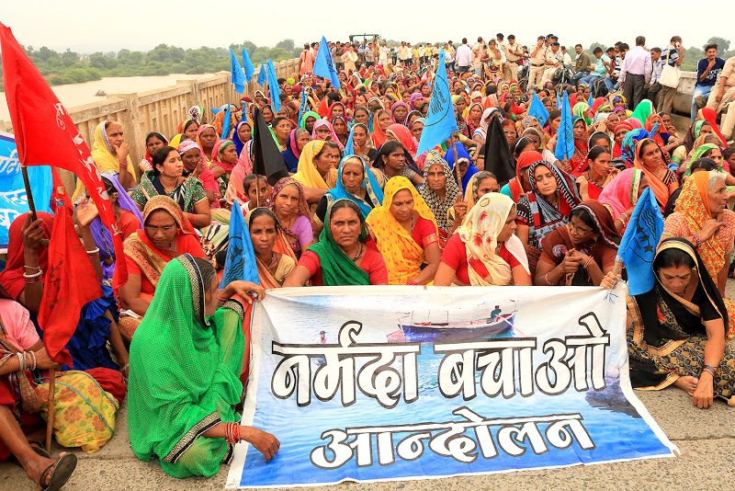

Narmada Bachao Andolan

Slide 65
4. Save the Western Ghats Movement (1980s–Present)
Overview:
The Western Ghats, a UNESCO World Heritage site, is one of the world's biodiversity hotspots. The Save the Western Ghats movement seeks to protect this ecologically sensitive region from deforestation, mining, and industrialization.
Objectives:
Biodiversity Conservation: Preserve the rich biodiversity and endemic species of the Western Ghats.
Sustainable Development: Advocate for development practices that do not harm the environment.
Legal Protection: Seek stronger legal frameworks to protect the region.
Key Events:
1980s–Present: Continuous activism against proposed projects like dams, mining operations, and infrastructure development that threaten the Western Ghats.
Key Figures:
R. Sukumar: A renowned ecologist and environmentalist involved in the conservation efforts.
Various NGOs: Organizations like the Bombay Natural History Society (BNHS) and Greenpeace India have been active in this movement.
Impact:
Protected Areas: Establishment of several protected areas and wildlife sanctuaries within the Western Ghats.

Slide 66
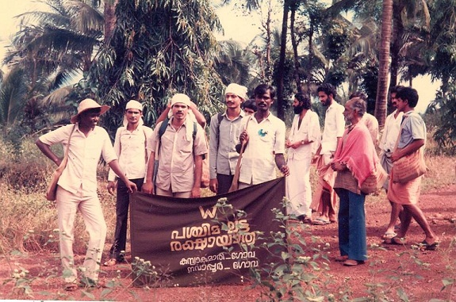


Save the Western Ghats Movement

Slide 67
5. Ganga Action Plan and Ganga Cleanliness Movements
Overview:
The Ganges River, considered sacred in India, has faced severe pollution due to industrial waste, sewage, and religious activities. Various movements and government initiatives aim to clean and preserve the Ganges.
Objectives:
Pollution Control: Reduce industrial and sewage pollution in the river.
Cultural Preservation: Maintain the religious and cultural significance of the Ganges.
Sustainable Practices: Promote practices that ensure the long-term health of the river ecosystem.
Key Events:
1986: Launch of the National Ganga River Basin Project (later known as the Ganga Action Plan) by the Indian government.
2014–Present: The Namami Gange Programme, a flagship initiative by the Government of India to clean and rejuvenate the Ganges.
Key Figures:
Vishwanath Pratap Singh: Former Prime Minister who initiated the Ganga Action Plan.
Govindappa Venkatasamy: Founder of Aravind Eye Care, who has advocated for Ganga cleanliness.
Impact:
Infrastructure Development: Construction of sewage treatment plants, riverfront developments, and industrial regulation.

Slide 68




Slide 69
UN Conference on Human Environment 1972
The United Nations Conference on the Human Environment (UNCHE), also known as the Stockholm Conference, was held in Stockholm, Sweden, from June 5 to 16, 1972. This was the first major international conference to address environmental issues on a global scale, and it is often regarded as the starting point of modern environmental governance. The conference's outcomes laid the foundation for global environmental action and awareness, leading to the creation of key environmental policies and organizations.
Objectives
The main goal of the UNCHE was to create a framework for international cooperation in addressing environmental challenges while balancing economic development and environmental protection.

Slide 70


UN Conference on Human Environment 1972

Slide 71
Key Points from the UN Conference on the Human Environment (1972)
Stockholm Declaration:
Contained some principles emphasizing the need for human rights to a healthy environment and the duty to protect the environment for future generations.
affirmed the right to a healthy environment.
acknowledged state sovereignty over natural resources but with the obligation not to harm other states’ environments.
Action Plan for the Human Environment:
Focused on environmental assessment, management, and cooperation.
Promoted the collection of environmental data and developing strategies for pollution control and resource management.
Creation of UNEP:
The conference led to the establishment of the United Nations Environment Programme (UNEP), tasked with coordinating international environmental efforts.
Focus on Developing Countries:
Highlighted the need for economic development in tandem with environmental protection, acknowledging the specific needs of developing countries and the necessity of international aid.
Environmental Diplomacy:
Laid the foundation for future environmental treaties and global governance frameworks for sustainable development.

Slide 72

THANK YOU

